Slide 1

Java Operators
Arithmetic operators
Unary operators
‘+’ → additive operators/string concatenator
‘-’ → subtraction operator
‘*’ → multiplication operator
‘/’ → division operator
‘%’ → remainder operator
‘++’ → increment operator
‘--‘ → decrement operator
‘!’ → logical compliment operator

Slide 2
Java Operator Continues
Equality and Relational
Conditional Operators
‘==‘ → Equal to
‘!=‘ → Not equal to
‘>’ → Greater than
‘<‘ → Less than
‘>=‘ → Greater than or equal to
‘<=‘ → Lesser than or equal to
‘&&’ → Conditional – And
‘||’ → Conditional – Or
‘?:’ → Ternary Operator

Slide 3

Ternary Operator
The ternary operator or ?, is a shorthand if else statement. It can be used to evaluate an expression and return one of two operands depending on the result of the expression.
boolean b = true; String s = ( b == true ? "True" : "False" );
Or the above can be written as
boolean b = true; String s; if(b == true){ s = "True"; }else{ s = "False"; }

Slide 4

Loops
Loops are the way of repeating lines of codes until loop condition is met.!!!!
Loops in java :
While loop
Do-while loop
For loop
Enhanced for loop -- ????

Slide 5
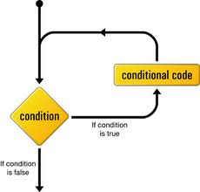
While loop
While loop repeats a block of code until the condition is true
While (condition)
{
// block of codes
}
//where condition is nothing but the Boolean expression

Slide 6
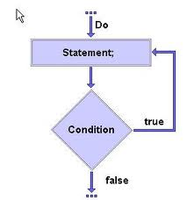
Do-while loop
Do-while loop is similar to the “while loop” but the only difference is that, in this the loop block is guaranteed to run at least one time!!!!
do
{
//all codes here
}
While (condition)
//since condition appears at the end, therefore the code block executes at least one

Slide 7
For loop
In for loop the initialization, condition checking and updating of loop element is done in a single line.
For(initialization; condition; update)
{
// codes
}
The initialization step is executed first, and only once. This step allows you to declare and initialize any loop control variables.
Next, the Boolean expression is evaluated. If it is true, the body of the loop is executed. If it is false, the body of the loop does not execute.
After the body of the for loop executes, the flow of control jumps back up to the update statement. This statement allows you to update any loop control variables.

Slide 8
Nesting of loops
The placing of one loop inside the body of another loop is known as Nesting of loops.
While working with nesting loops the outer loop will change only when inner loop is completely finished.
For (int outer =0; outer<5 ; outer++)
{
For (int inner= 0; inner <3; inner++)
{
System.out.println(“outer is “ + outer + “inner is“ + inner);
}//inner loop ends
}//outer loop ends

Slide 9
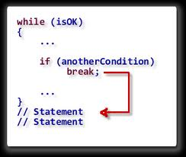
Break and Continue statements
Break and Continue statements are used to change the normal flow of compound statement.
The break statement immediately jumps to the end of the compound statement.
The continue statement immediately jumps to the next iteration of the compound statement.
for (int outer=0; outer< 12; outer++)
{
if(outer ==3)
continue;
System.out.println(outer);
if(outer ==7)
break;
}

Slide 10
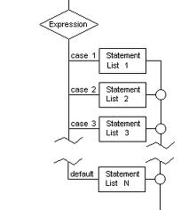
Switch statement
Switch statement is the shorthand for multiple ‘if-else’ statement, which allow us to choose a single path from a number of execution path.
Switch statement works with char, short, byte, int and String.
switch(x)
{
case 1:
System.out.println("case1");
break;
case 2:
System.out.println("case2");
break;
case 3:
System.out.println("case 3");
break;
Default
System.out.println(“default case”)
}

Slide 11
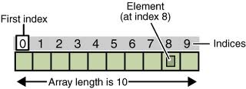
Arrays
Arrays are the collection of similar datatypes.
Each variable in an array is known as ‘array element.
Each variable of array is referenced by a particular integer number which is known as ‘array index’.
The total number variables in array decide the length of the array.

Slide 12

Declaration and initialization of array
In java array is an object, therefore it is declared and initializes like an object.
Declaration of array variable:
int[] array;
Constructing the array:
new int[(length of the array)];
Assigning array to array variable:
array = new int[(length of the array)];
Initialization of array:
Array[0] = 34;
Declaration and initialization in single line:
Int[] array = { 34, 56, 7, 23, 34,};

Slide 13

Initialization of array using loop
Arrays can be initialized by using loops.
int [] array = new int[34];
for (int i=0;i<array.length;i++)
{
array[i]=i;
System.out.println(array[i]);
}

Slide 14
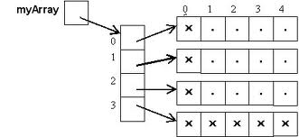
Multidimensional arrays
Multi-dimensional arrays are nothing but the “array of arrays” where each element represents a single dimensional array.
Here ‘myArray’ is a 2-d array, whose each element contains a single dimensional array.

Slide 15
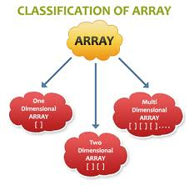
Initialization and declaration of 2-d array
for(int i=0;i<myArray2.length;i++)
{
for (int j= 0; j<myArray2[i].length;j++ )
{
myArray2[i][j]= j;
}
}
for (int i=0; i<myArray2.length;i++)
{
for (int j=0 ; j<myArray2[i].length; j++)
{
System.out.print(myArray2[i][j] + "\t");
//System.out.print("\t");
}
System.out.println();
}

Slide 16
Program #1 : pyramid of Stars
public class Test {
public static void main(String [] args )
{
for (int outer =1; outer<=5; outer++ )
{
for (int inner = 0; inner<outer; inner++)
{
System.out.print(“*”);
}
System.out.println();
}
}
}

Slide 17
Enhanced for loop
“Enhanced for loop” is introduced in java 5, in order to simply the way to iterate a collection or array.
In this the loop continues till the last element of the collection or array.
for (int y : array)
{
System.out.print(y);
}

Slide 18
Enhanced for loop for 2-d array
for(int[] x : myArray2)
{
for (int y : x)
{
System.out.print(y + "\t");
}
System.out.println();
}

